Slide 1



Principles and problems of de novo genome assembly
Lex Nederbragt
Norwegian High-Throughput Sequencing Centre (NSC)
and
Centre for Ecological and Evolutionary Synthesis (CEES)

Slide 2
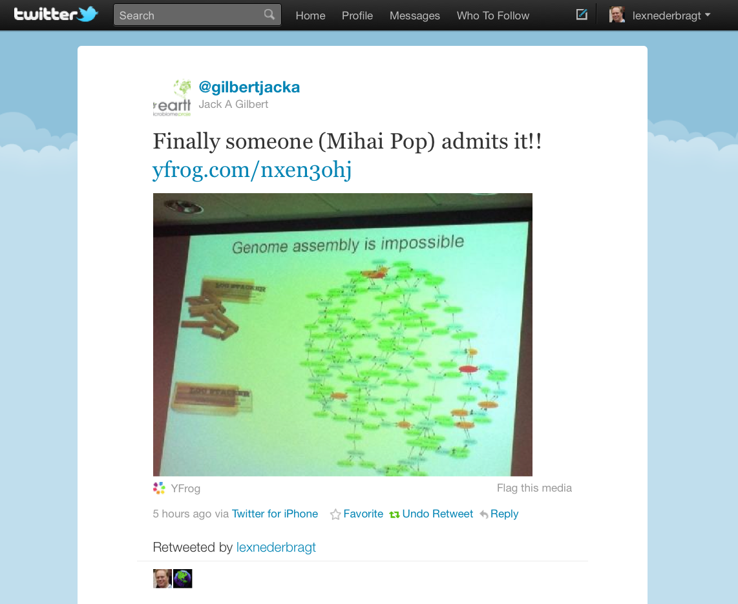

Slide 3
What is this thing called ‘genome assembly’?

Slide 4
What is a genome assembly?
A hierarchical data structure
that maps the sequence data
to a putative reconstruction of the target
Miller et al 2010, Genomics 95 (6): 315-327

Slide 5
Hierarchical structure
reads
contigs
scaffolds

Slide 6
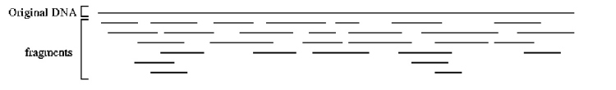
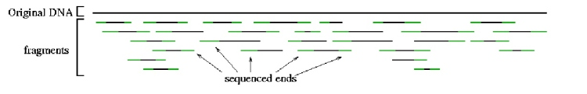
Sequence data
reads
contigs
scaffolds
Reads
original DNA
fragments
original DNA
fragments
Sequenced ends
http://www.cbcb.umd.edu/research/assembly_primer.shtml

Slide 7
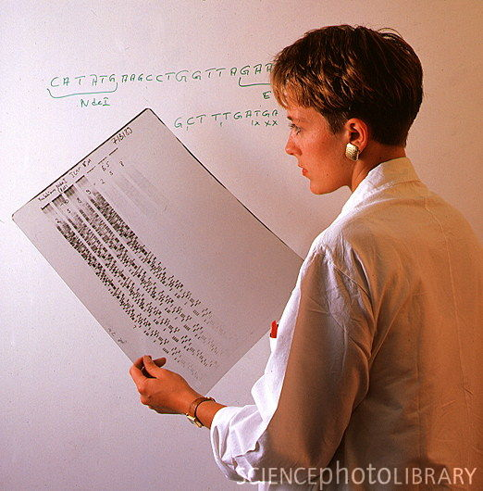
Reads!
reads
contigs
scaffolds
http://www.sciencephoto.com/media/210915/enlarge

Slide 8
Contigs
reads
contigs
scaffolds
Building contigs

Slide 9
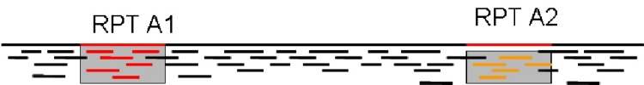
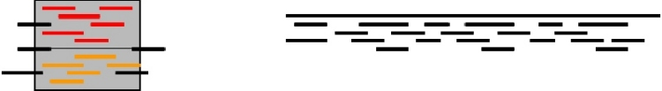
Contigs
reads
contigs
scaffolds
Building contigs
Repeat copy 1
Repeat copy 2
Contig orienation?
Contig order?
Collapsed repeat consensus
http://www.cbcb.umd.edu/research/assembly_primer.shtml

Slide 10
Contigs
reads
contigs
scaffolds
Repeats: major problem
Repeat copy 1
Repeat copy 2
http://www.cbcb.umd.edu/research/assembly_primer.shtml

Slide 11
Mate pairs
reads
contigs
scaffolds
Other read type
Repeat copy 1
Repeat copy 2
(much) longer fragments
mate pair reads

Slide 12
Mate pairs
Paired end reads → 100-500 bp insert
original DNA
fragments
Sequenced ends
Mate pairs → 2-20 kb insert
Repeat copy 1
Repeat copy 2
mate pair reads

Slide 13
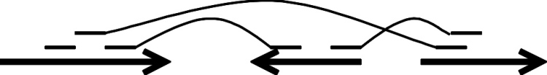
Scaffolds
reads
contigs
scaffolds
Ordered, oriented contigs
mate pairs
contigs
gap size estimate

Slide 14
Hierarchical structure
reads
contigs
scaffolds

Slide 15
Assembly
How to do this?
Algorithms

Slide 16
Algorithms
All are graph-based
Read 1
Read 2
Overlap
Graph-theory!

Slide 17
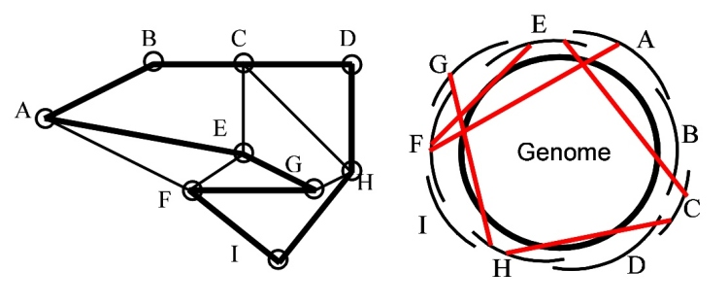
Algorithms
Hamiltonian path
a path that contains all the nodes
http://www.cbcb.umd.edu/research/assembly_primer.shtml

Slide 18
Algorithms
Overlap calculation (alignment)
computationally intensive
Read 1
Read 2
Overlap

Slide 19
Algorithms
Path through the graph
→contig
Read 1
Read 2
Read 3
Read 4
Overlap
Overlap
Overlap

Slide 20

Algorithms
Many flavors
Abandoned
→ Greedy extension
Two most used
Overlap Layout Consensus
de Bruijn graph
http://www.waialuasodaworks.com/images/flavors2009.jpg

Slide 21
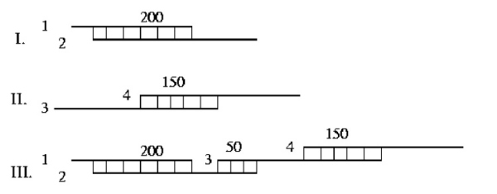
Greedy extension
Oldest
http://www.cbcb.umd.edu/research/assembly_primer.shtml
Notes:
Greedy assemblers - The first assembly programs followed a simple but effective strategy in which the assembler greedily joins together the reads that are most similar to each other. An example is shown in Figure 8, where the assembler joins, in order, reads 1 and 2 (overlap = 200 bp), then reads 3 and 4 (overlap = 150 bp), then reads 2 and 3 (overlap = 50 bp) thereby creating a single contig from the four reads provided in the input. One disadvantage of the simple greedy approach is that because local information is considered at each step, the assembler can be easily confused by complex repeats, leading to mis-assemblies.

Slide 22
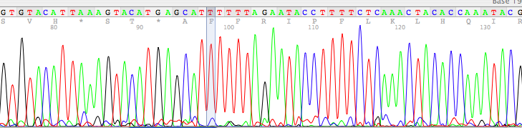
Overlap-Layout-Consensus
Typical for Sanger-type reads
also used by newbler from 454 Life Sciences

Slide 23
Overlap-Layout-Consensus
Steps
Overlap computation
Layout: graph simplification
Consensus: sequence

Slide 24
Overlap-Layout-Consensus
Overlap phase:
K-mer seeds initiate overlap
ACGCGATTCAGGTTACCACG

Slide 25
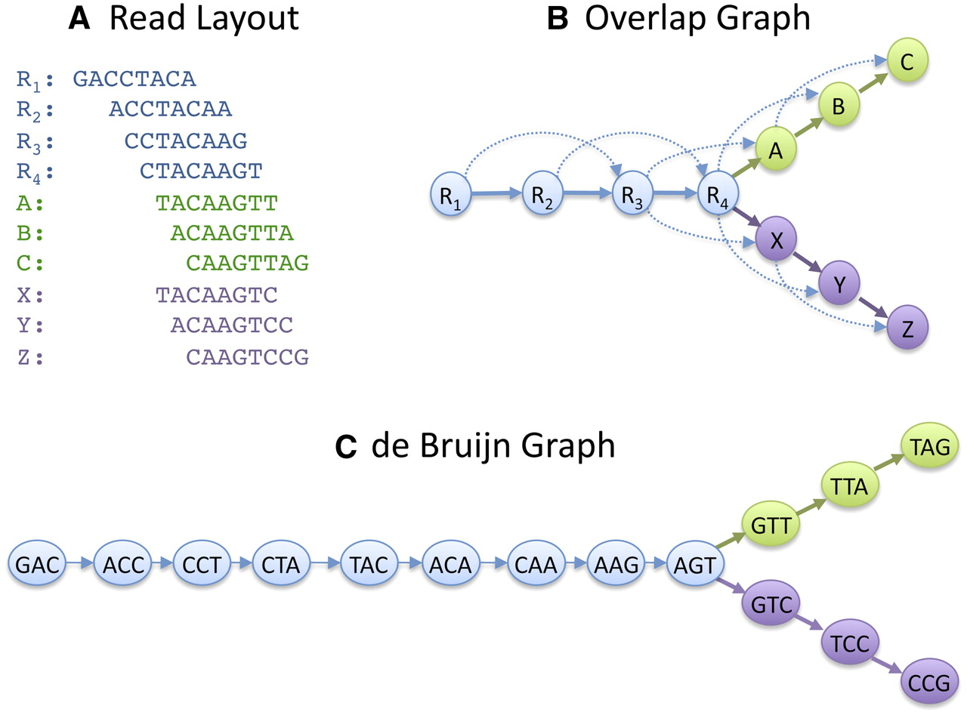
Overlap-Layout-Consensus
Schatz M C et al. Genome Res. 2010;20:1165-1173

Slide 26

de Bruijn graphs
Developed outside of DNA-related work
Best solution for very short reads ≤100 nt
Read
GACCTACA
GAC
ACC
CCT
CTA
TAC
ACA
de Bruijn graph
K-mers (K=3)
K-1 bases overlap

Slide 27
Graphs
Schatz M C et al. Genome Res. 2010;20:1165-1173

Slide 28
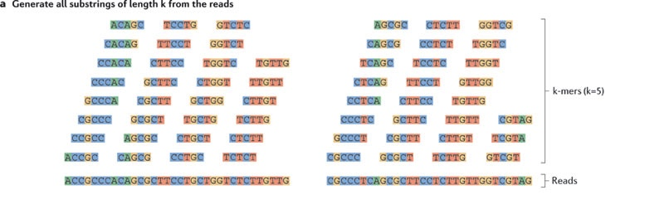
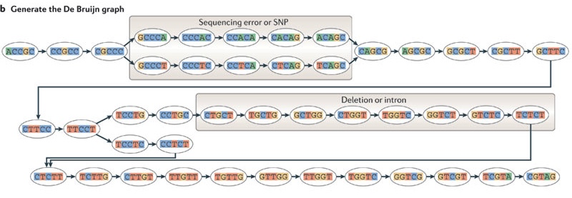
Simplifying
Fig 4 from doi:10.1038/nrg3068

Slide 29
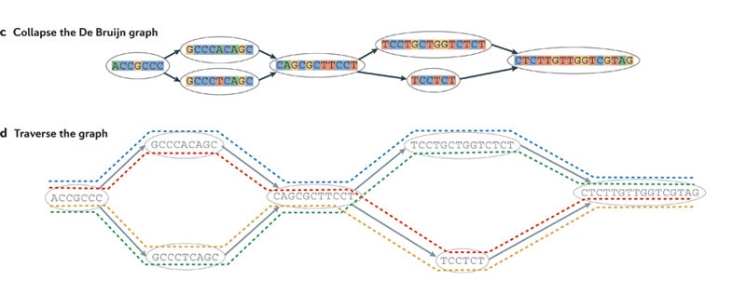
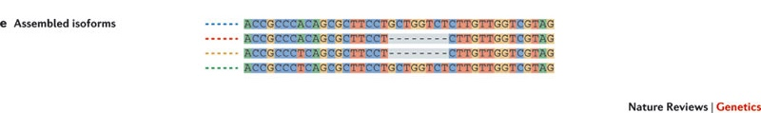
Simplifying
Fig 4 from doi:10.1038/nrg3068

Slide 30
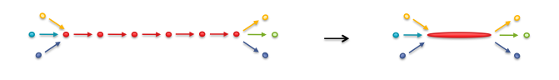
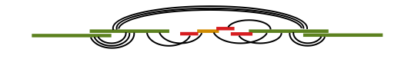
Graphs
Simplify the graph
Add scaffolding information

Slide 31
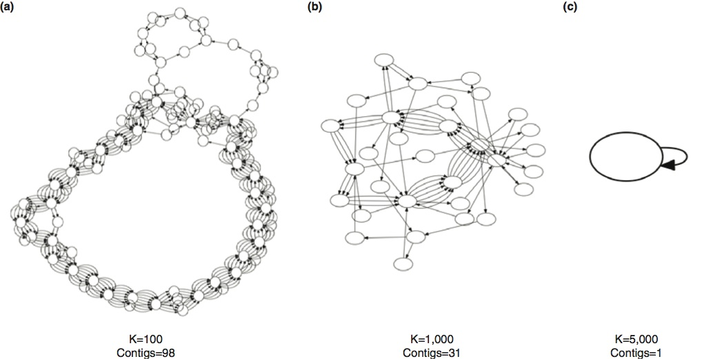
Read length matters
5.2 Mb circular genome, infinite error-free reads
Roberts et al (2013) doi:10.1186/gb-2013-14-6-405

Slide 32
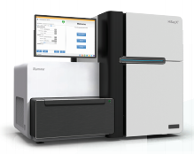
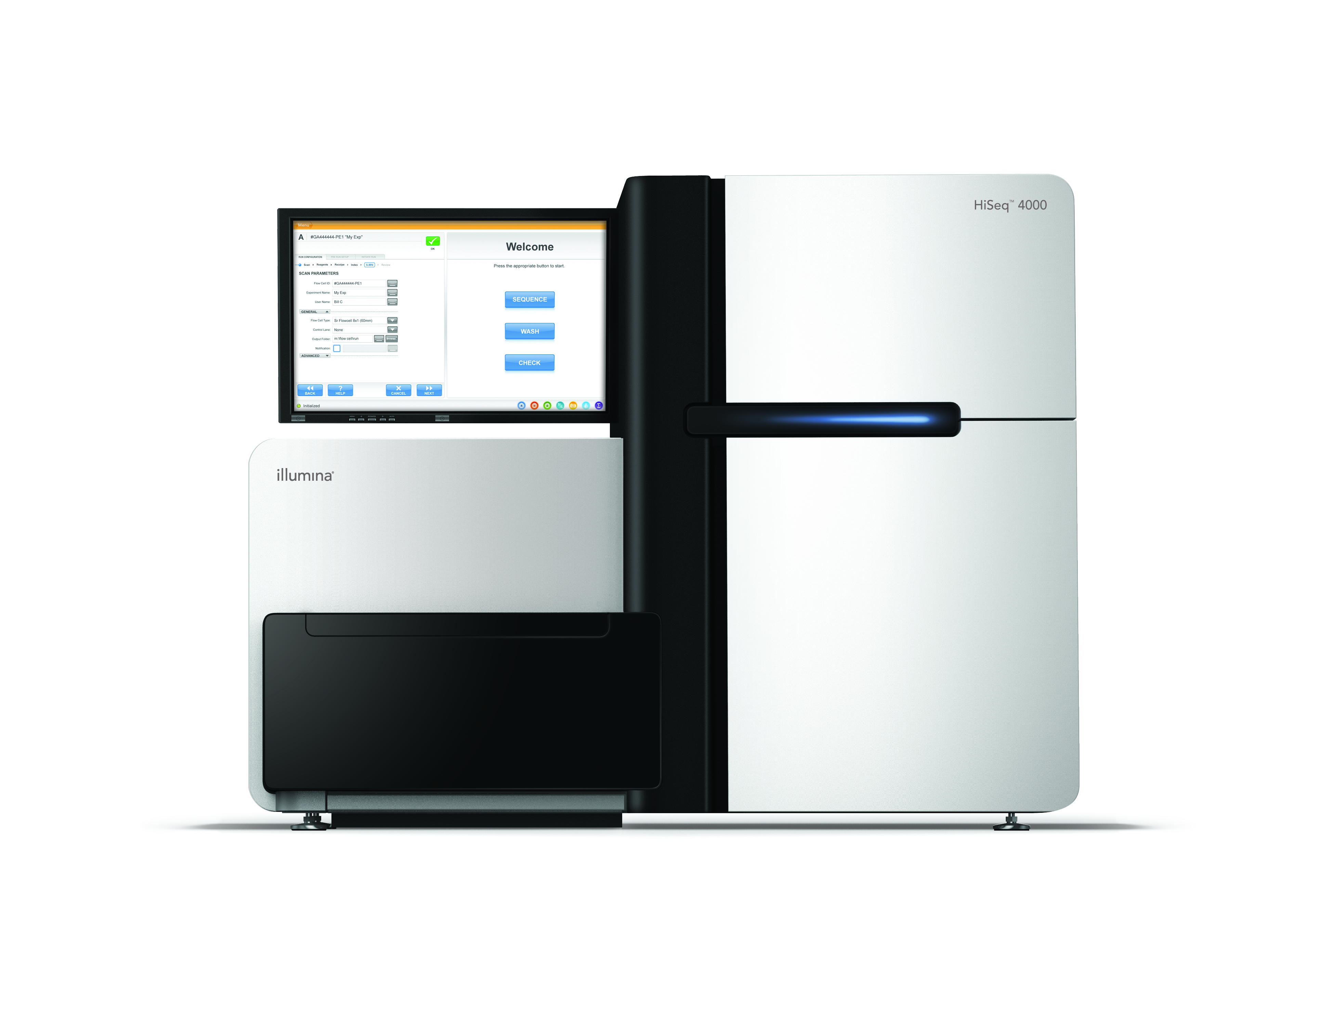
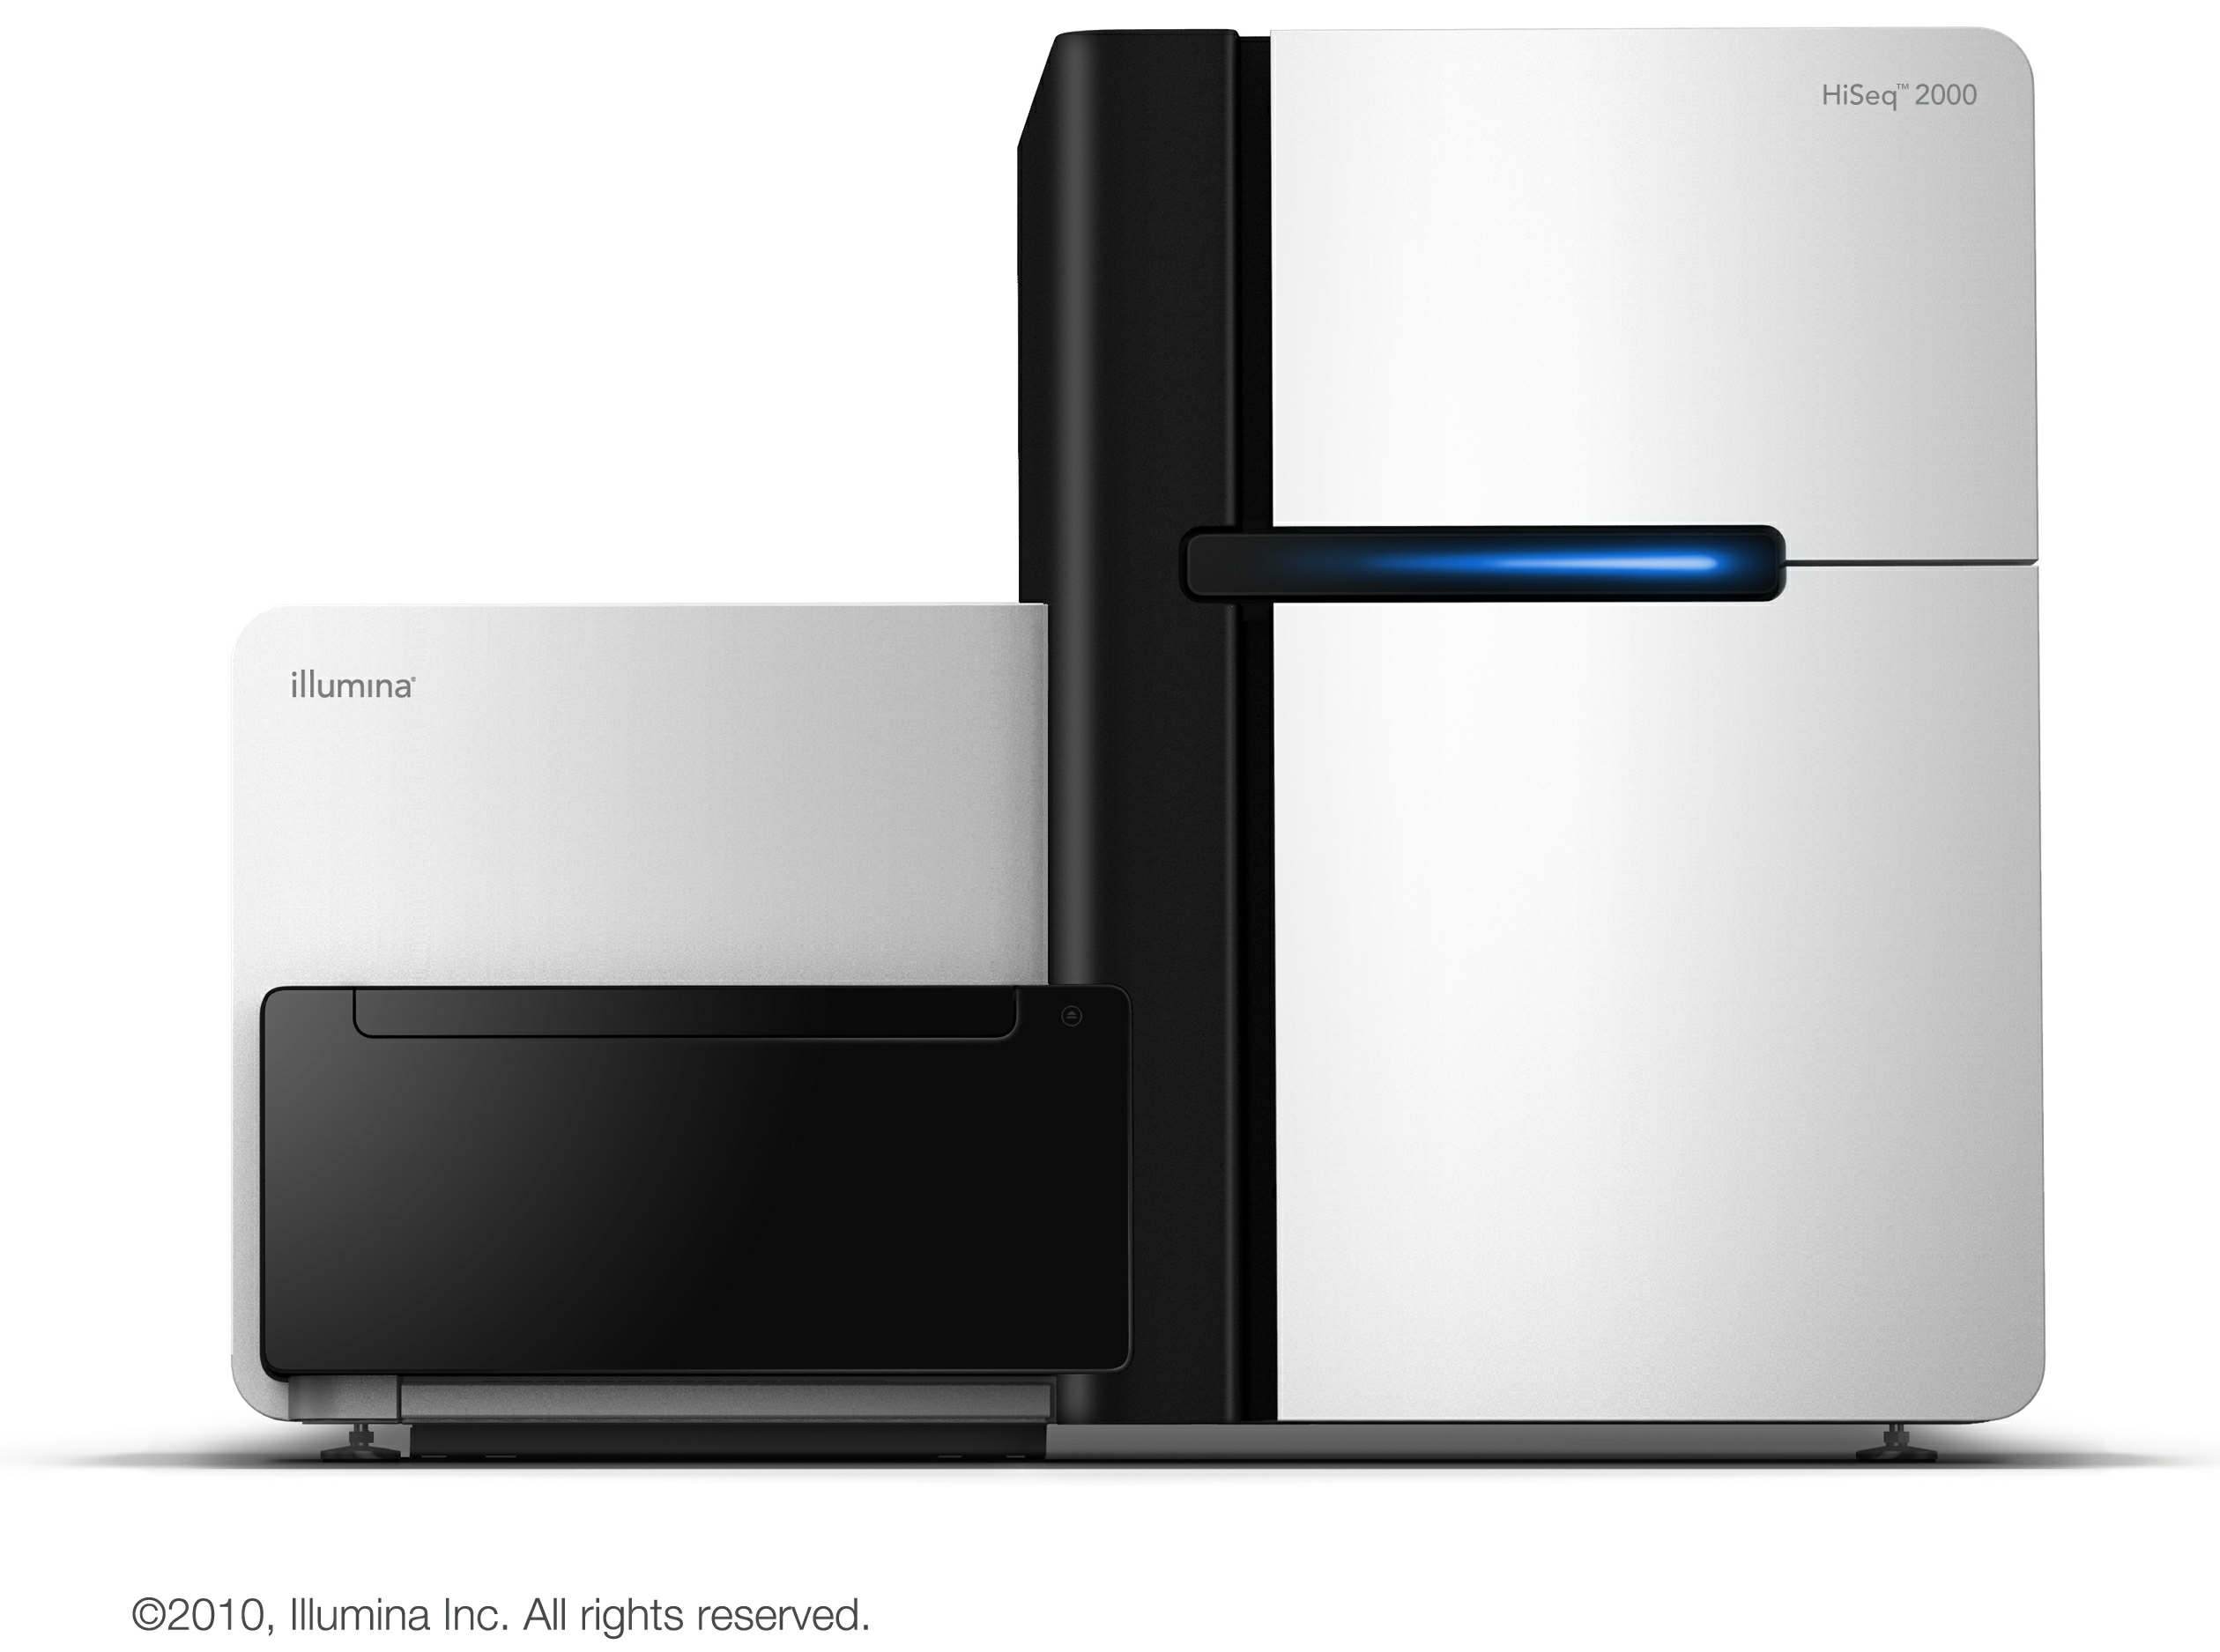
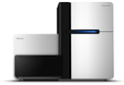
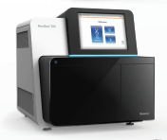
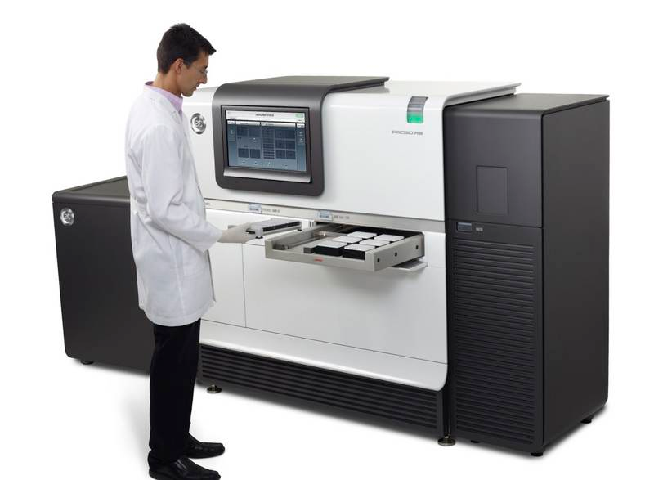
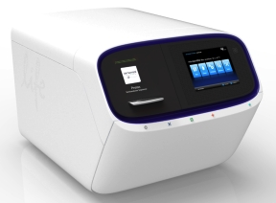
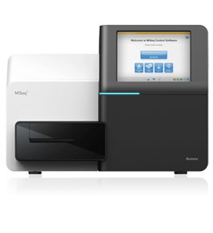
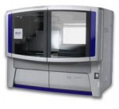
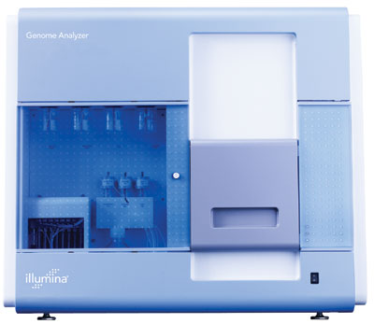
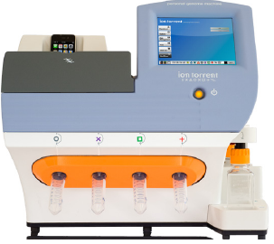
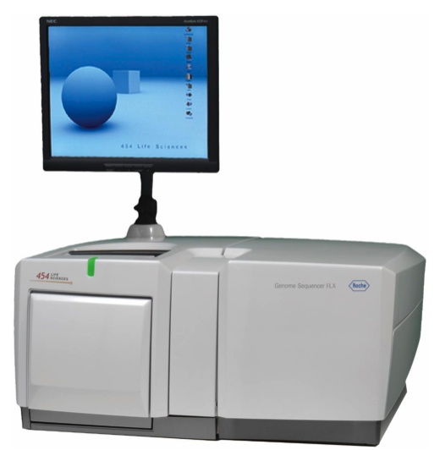
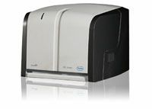
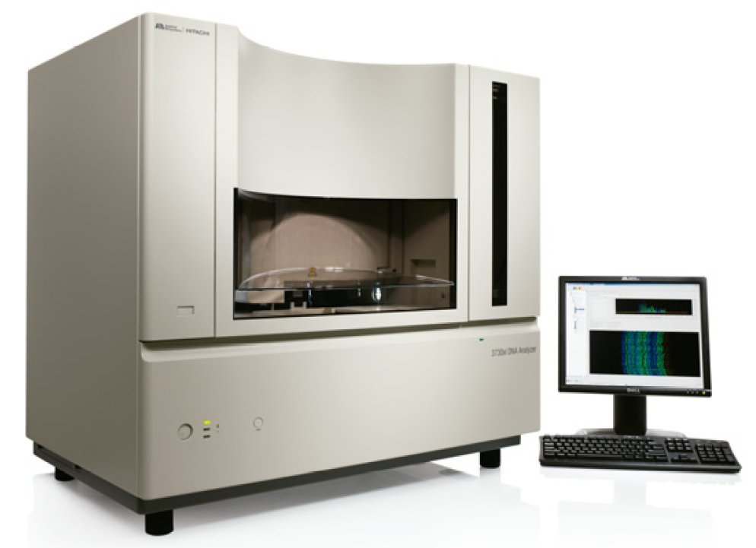
Developments in
High Throughput Sequencing
Hiseq X
Hiseq 4000
Hiseq
2000/2500
Hiseq2500 RR
NextSeq 500
Proton
MiSeq
PacBio RS
SOLiD
GA II
PGM
GS FLX
GS Junior
‘Sanger’
Lex Nederbragt (2012-2015) http://dx.doi.org/10.6084/m9.figshare.100940
Notes:
October 2013

Slide 33
Developments in
High Throughput Sequencing
Hiseq X
Hiseq 4000
Hiseq
2000/2500
Hiseq2500 RR
NextSeq 500
Proton
MiSeq
PacBio RS
SOLiD
GA II
PGM
Long
‘Sanger like’
GS FLX
GS Junior
Short
Intermediate
‘Sanger’
Lex Nederbragt (2012-2015) http://dx.doi.org/10.6084/m9.figshare.100940
Notes:
October 2013

Slide 34
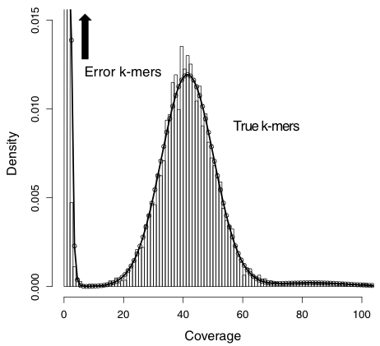
Quality matters
Sequencing errors
add complexity to graph
create new k-mers
Correction of errors
k-mer frequency
Kelley et al. Genome Biology 2010 11:R116

Slide 35
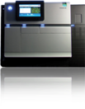
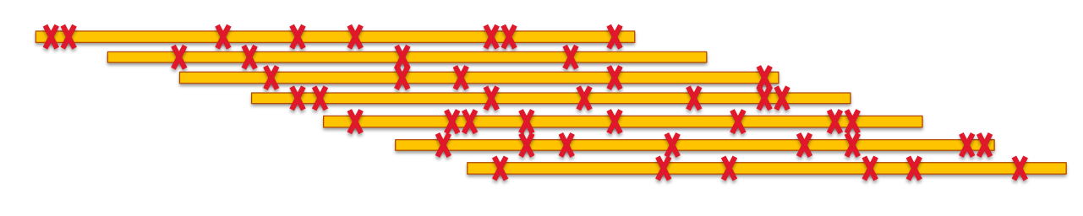
Quality matters
Too many errors → hard to find overlaps
http://schatzlab.cshl.edu/presentations/2012-01-17.PAG.SMRTassembly.pdf

Slide 36
Why is genome assembly such a difficult problem?

Slide 37
1) Repeats
Repeat copy 1
Repeat copy 2
Repeats break up assembly
Collapsed repeat consensus
http://www.cbcb.umd.edu/research/assembly_primer.shtml

Slide 38
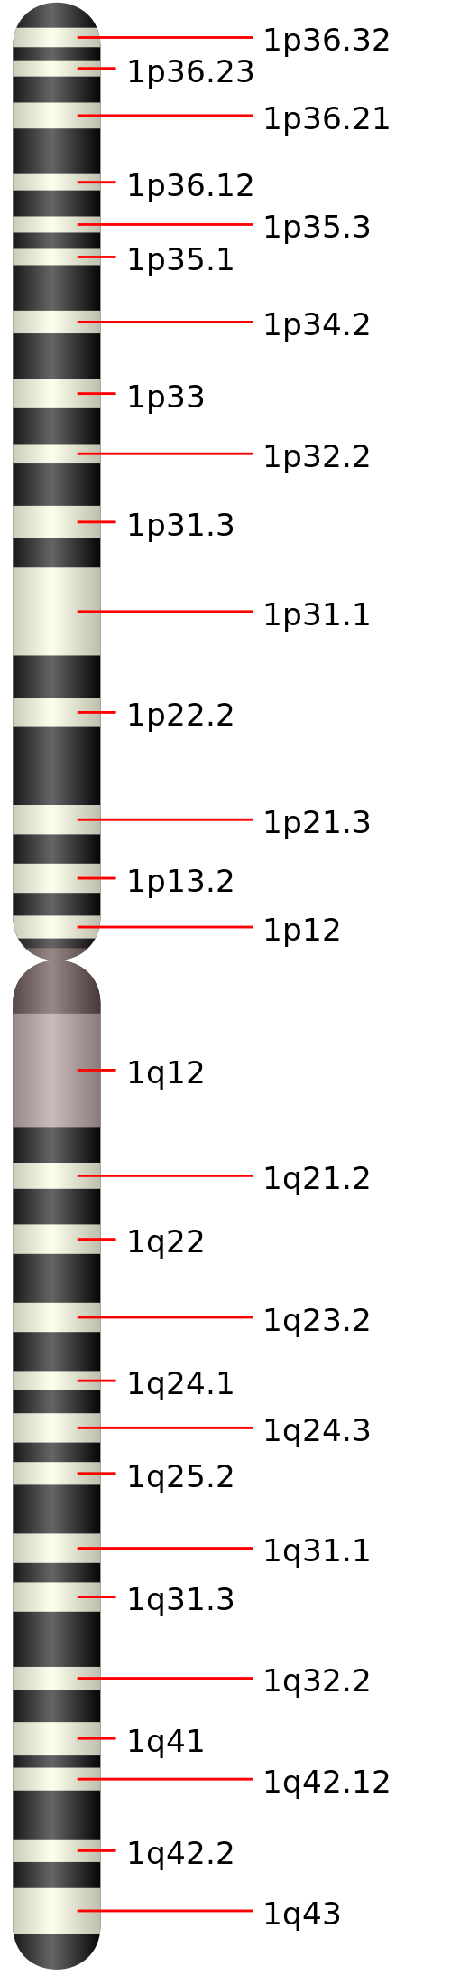
2) Diploidy
Differences between sister chromosomes
‘heterozygosity’
*
*
*
http://commons.wikimedia.org/wiki/File:Chromosome_1.svg

Slide 39
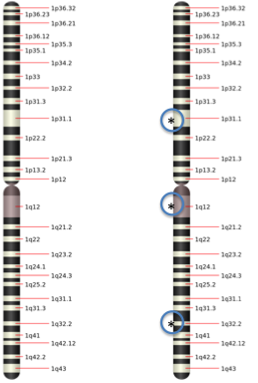
2) Diploidy
Polymorphic region 2
Region 1
Region 4
Polymorphic region 3
Homozygous
Heterozygous
Homozygous

Slide 40
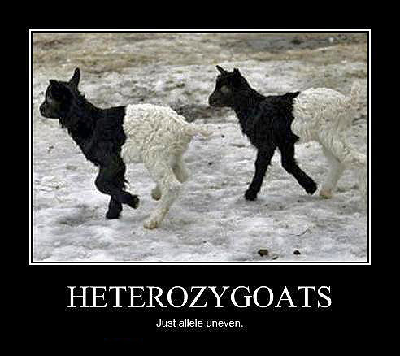
2) Diploidy
http://www.astraean.com/borderwars/wp-content/uploads/2012/04/heterozygoats.jpg
and many other sites

Slide 41
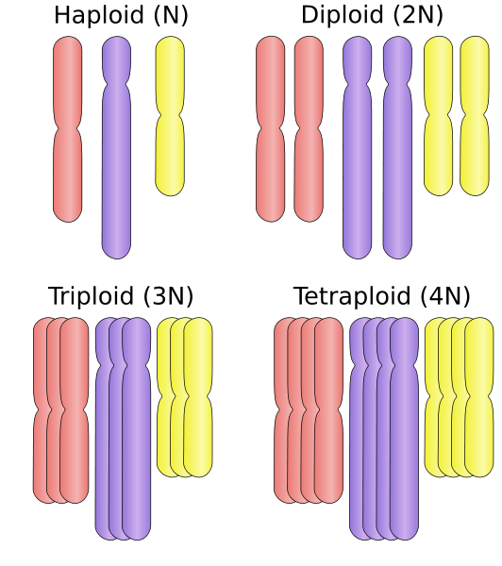
3) Polyploidy
http://en.wikipedia.org/wiki/Polyploidy

Slide 42
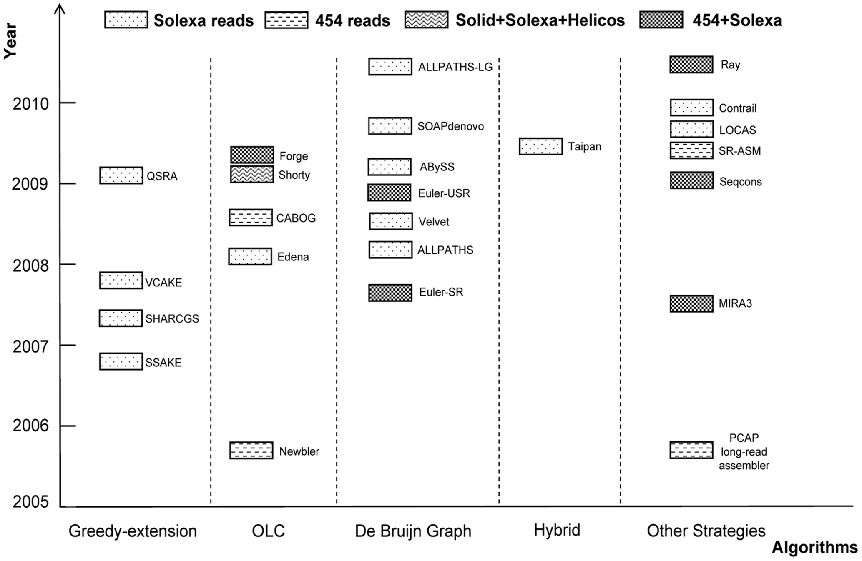
4) Many programs to choose from
Zhang et al. PLoSOne 2011

Slide 43
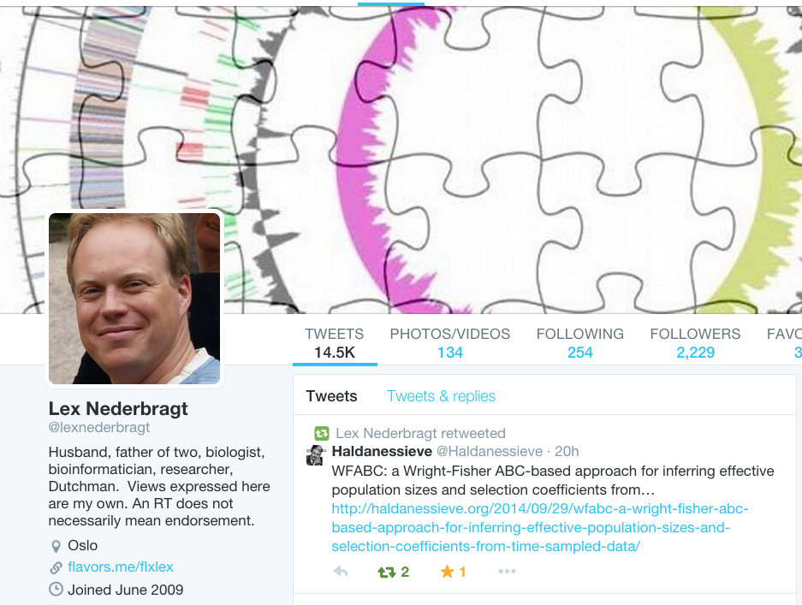
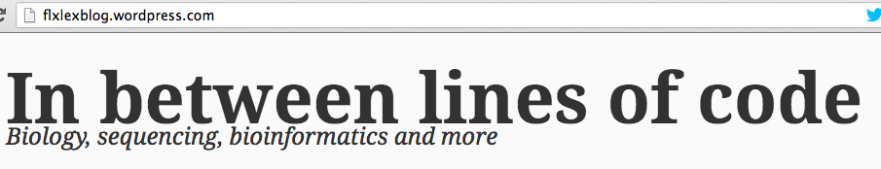
Shameless self-promotion

